Slide 1
Container’s Filesystem
ow

Slide 2
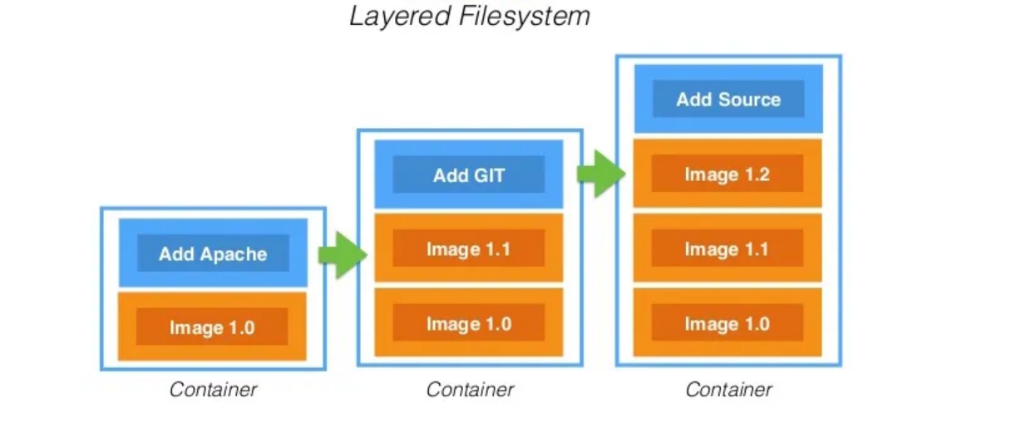
overview

Slide 3
..
Think of a Docker image like a layered cake. Each layer adds something new—maybe one layer is the OS, another has application files, and another adds configurations.
The Docker storage driver is like a smart organizer—it stacks these layers and presents them as a single, unified filesystem, so the container sees everything as one complete system instead of separate layers.
When a container runs, it starts with these read-only layers from the image. But since a running container needs to modify files, Docker adds a thin, writable layer on top. This is where any changes (like writing new files or modifying existing ones) happen.

Slide 4
..
Filesystem Isolation:
Each container gets its own isolated filesystem.
It’s like creating a separate folder (rootfs) for the container and "chroot-ing" (changing the root directory) into it.
Features of Docker Filesystem:
Layering: Each container is built on top of multiple stacked layers.
Copy-on-Write (CoW): Instead of copying everything, Docker only copies files when changes are needed.
Caching: Docker stores layers efficiently, so if multiple containers use the same base image, it doesn’t download it multiple times.

Slide 5
chroot
chroot (short for change root) is a command in Linux that changes the apparent root directory (/) for a process and its children. This creates an isolated environment, preventing the process from accessing files outside the new root.
How It Works (Simple Analogy)
Imagine you are in a house with many rooms (your full filesystem). When you use chroot, it's like locking yourself inside a single room and pretending the rest of the house doesn't exist. You can move around inside the room, but you can't access anything outside.

Slide 6
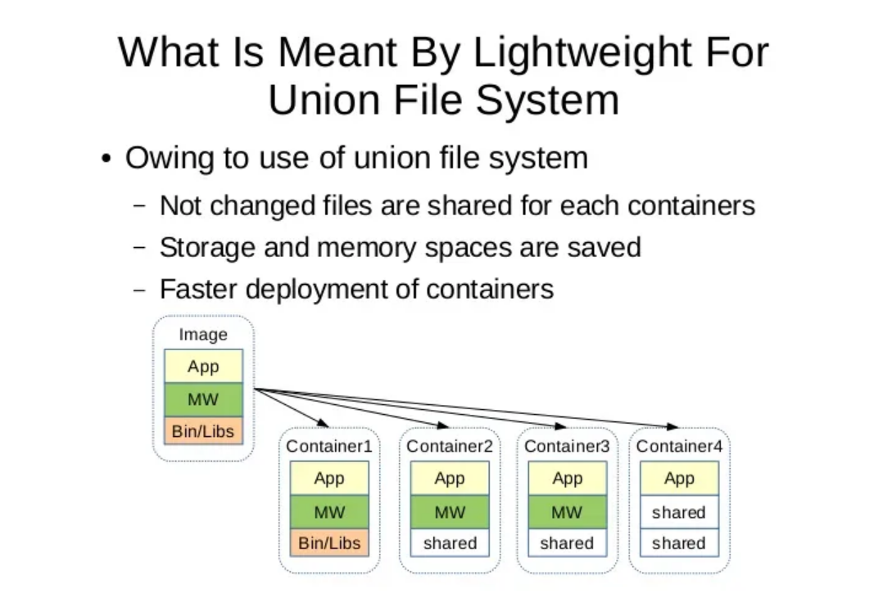
..

Slide 7
What is a Union File System?
A Union File System (UnionFS) is a type of filesystem that allows multiple layers to be stacked together while appearing as a single unified filesystem.
Why is it Lightweight?
Shared Layers: Instead of duplicating all files for every container, unchanged files are shared among multiple containers.
Saves Storage & Memory: Since containers reuse existing layers, they consume less disk space and memory.
Faster Deployment: Containers don’t need to copy the entire filesystem; they just add their modifications on top of shared layers.

Slide 8
…
Explanation of the Image
The base image contains the application (App), middleware (MW), and binaries/libraries (Bin/Libs).
When Container 1 starts, it gets a full copy of the image.
When Container 2, 3, and 4 start, they reuse the existing layers (MW and Bin/Libs) instead of copying them.
Only the changes made by each container are stored separately, reducing redundancy.
Real-World Benefit
This makes Docker containers fast and efficient because they don’t have to duplicate unnecessary data, making it easy to run multiple containers with minimal overhead

